Slide 1

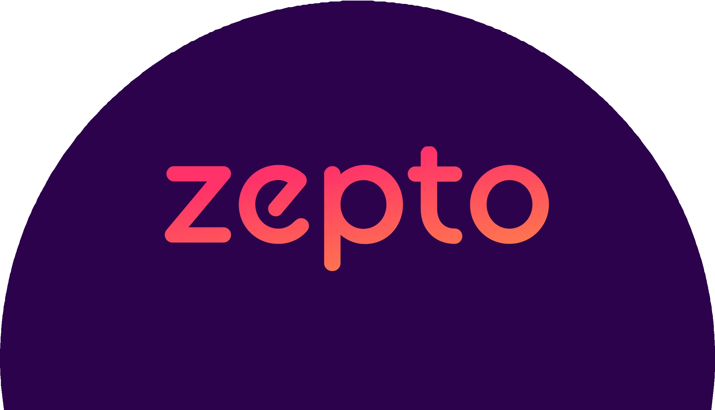
Product Teardown

Slide 2
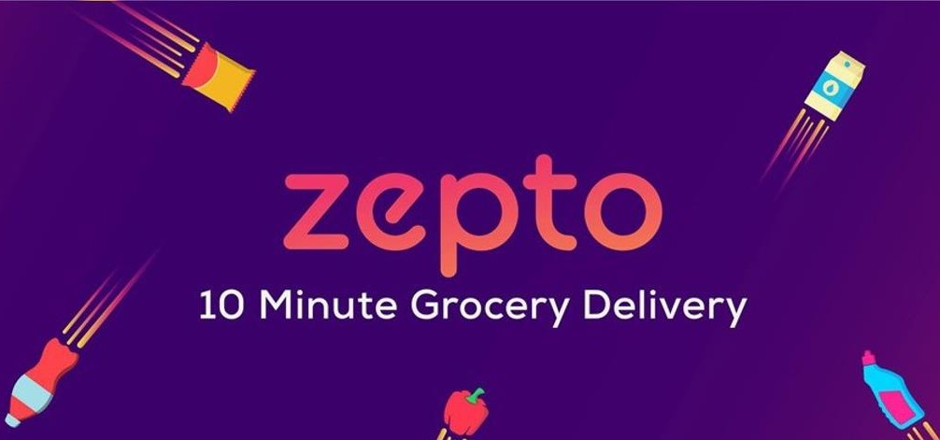
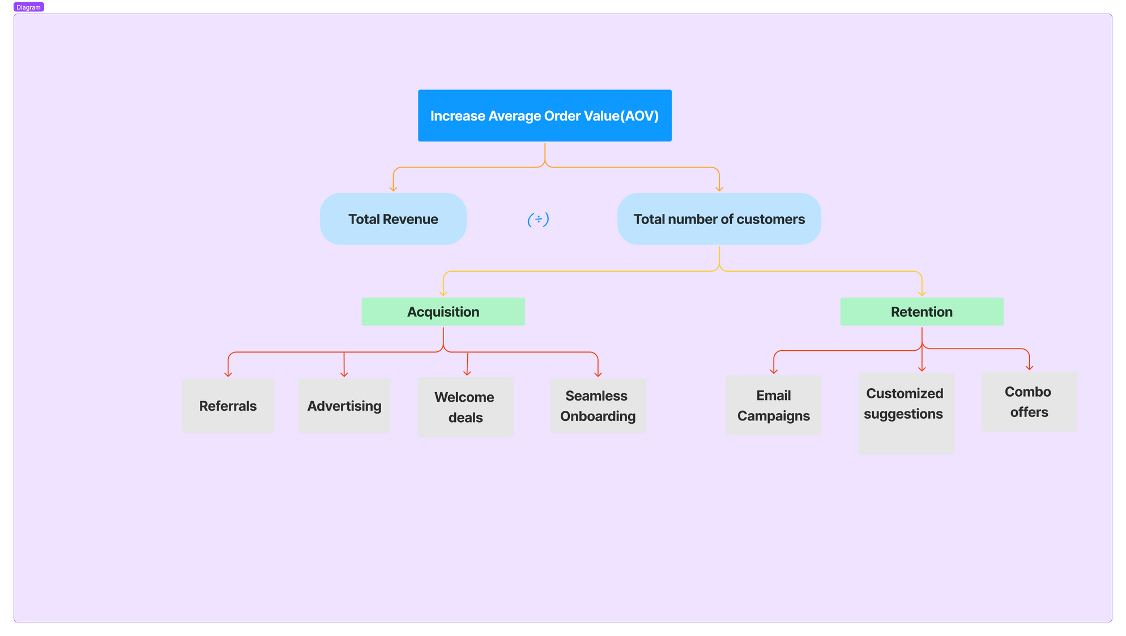


Goal :
The goal is to enhance the Average Order Value (AOV) to ₹600 by improving product discovery and engagement on the app. Additionally, we aim to boost customer retention by enhancing the overall purchase experience, encouraging more frequent and larger orders.
Understanding the Current State :
Customer retention rate has plateaued at around 45%.
Current AOV is ₹460, lower than Blinkit's ₹607.
Operates in over 30 cities across India.
Rapid delivery service promises 10-minute deliveries.
Statistics :
29%
Market share in online grocery delivery
Relevant Business and Product Outcomes
:
₹460
Average Order Value
$600 M
GMV
10
Servicable Cities
Buisness Model :
Revenue Streams
Zepto offers premium subscription plans to users, providing benefits like faster delivery and
exclusive deals.
Value Proposition
Zepto provides convenience, a wide product selection, and personalized recommendations to enhance user experience.

Slide 3
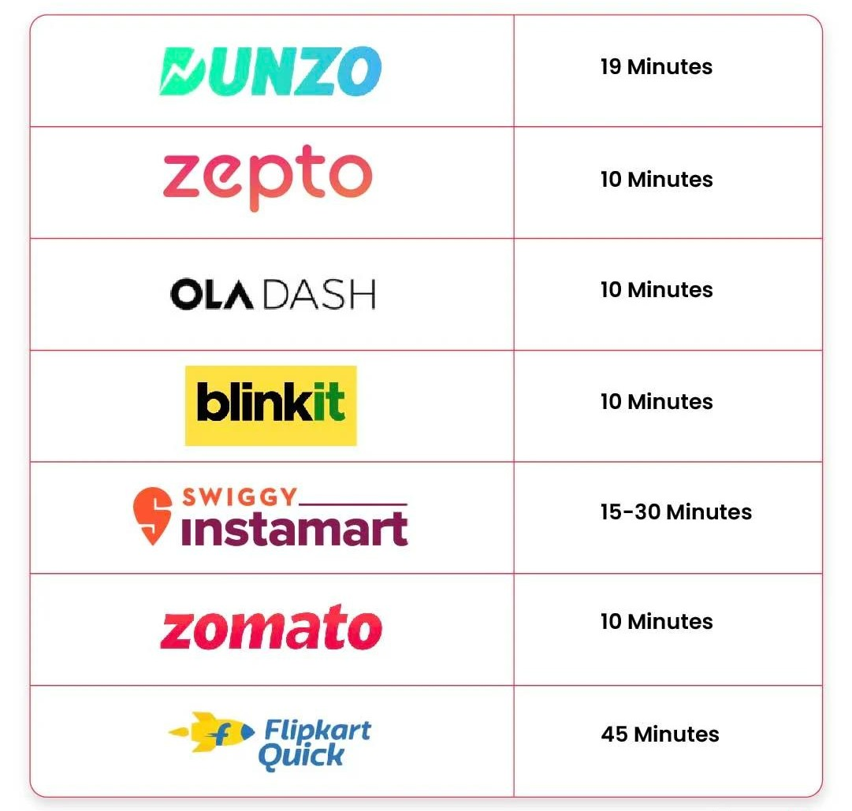

About Zepto :
Major Competitors
:
Quick Commerce Leader: Zepto specializes in delivering groceries within 10 minutes, operating in over 30 cities across India, which sets it apart in the competitive quick commerce sector.
Diverse Product Offering: The app provides a wide range of grocery items, from fresh produce to daily essentials, catering to various customer needs.
User-Centric Experience: With features like personalized recommendations and in-app cooking classes, Zepto enhances user engagement, aiming to improve customer retention and increase average order value.
Currently, the company operates across major cities, including Bengaluru, Delhi, Mumbai, Gurugram, Noida, Ghaziabad, Hyderabad, Chennai, Pune, and Kolkata.
Value Proposition: Delivers Groceries with in 10 Minutes.
1000+ Employees.
5000+ Products.

Slide 4
PROBLEM STATEMENT
PROBLEM IDENTIFICATION
Despite Zepto's success in the quick commerce grocery sector, its customer retention rate has plateaued at around 45%. Additionally, the average order value (AOV) stands at ₹460, significantly lower than competitors like Blinkit, which has an AOV of ₹607. To sustain growth, Zepto needs to implement strategies to boost AOV, enhance product discovery, and improve the overall purchase experience.
Current order value RS. 460 (Based on user and market research)
Goal Increase AOV by 30-
40%
[RS.600-640]
Improve Unit Economics
Competitive Strategies:
Potential Solutions:
Logistics and Efficiency:
Analyze successful tactics from competitors.
Why to increase the order value
Achieve Profitability
Explore bundling products, Personalized Upselling Recommendations, and loyalty programs.
Ensure solutions do not compromise the 10-
minute delivery promise.
Increase Revenue and Growth
PROPOSED INITIATIVES TO INCREASE AOV
Sorting and Increasing Quantity Option: Display options to increase quantity with price benefits (e.g., showing the price for 500gms and a lower price for 1kg).
Group Orders: Allow customers to create and manage group orders for a shared shopping experience, encouraging larger cart sizes.
AI-Driven Recommendations: Implement a chatbot that interacts with users, offering personalized product suggestions to enhance cart value.
In-App Cooking Classes: Provide cooking classes within the app to engage users and promote specific ingredients, leading to increased purchases.
PREFERENCES REVEALED: USER SURVEY INSIGHTS
These data are derived from Survey (primary research) submitted by 10
online grocery delivery users.
80%
Exclusive deals or discounts for orders.
70%
Frequent shoppers and ease of user experience
50%
Fast delivery with quality serivce

Slide 5


USER PERSONA
Discovering the reality from the ground
Name : Alpha
Age : 35
Name : Beta
Age : 25
Name : Gamma
Age : 20
Demography
Location : Hyderabad
Location : Chennai
Location : Bengaluru
Fast Delivery: Customers seek quick delivery times to enhance convenience.
User-Friendly Interface: An intuitive app design with easy navigation and payment options is essential.
Consistent Delivery Times: Users are frustrated by delivery delays and lack of reliability.
Product Quality: Concerns about the freshness of fruits and vegetables, and damaged items upon delivery, are significant pain points.
Fast Delivery: Receive groceries quickly within 10 minutes.
Quality Selection: Access a variety of fresh products.
Easy Shopping: Enjoy a user-friendly app for seamless ordering.
Time Constraints: Users need a quick and
Efficient Reordering: Users desire a one- click reorder feature for their frequently purchased items to save time and streamline the shopping process.
Assurance of Quality: Concerns about product quality and authenticity hinder their confidence in making purchases.
Attractive Promotions: They seek regular bundled deals and promotions that incentivize bulk purchases and help them save money.
efficient ordering process to accommodate their
busy schedules.
Multi-tasking Capability: They require the ability to shop while cooking or working, allowing them to manage multiple responsibilities.
Personalized Recommendations: Users are frustrated by generic product suggestions that do not align with their specific preferences.
Trust in Product Quality: Concerns about the authenticity of products and unreliable delivery times affect their confidence in the service.
User needs &
Pain Points
Streamlined Ordering: Achieve a fast and efficient shopping experience that saves time.
Reliable Delivery Assurance: Gain confidence in the authenticity of products and consistency in delivery times.
Value-Oriented Shopping: Take advantage of bundled deals and promotions to encourage bulk buying and maximize savings.
Quick Reordering: Enable fast and efficient reordering of frequently purchased items with a one-click feature.
Goals

Slide 6

PRIORITIZATION OF SOLUTIONS
PRIORITIZATION SCALE
LOW(1), MID(2), HIGH(3)
AI Drivem Recommendations (Chef BOT)
Sorting and Increasing Quantity
Group
Orders
In-App Cooking
classes
How it works?
This feature allows customers to
view different pricing tiers based on the quantity they purchase.
Key Features:
Bulk Discounts | Quantity Price Display | Savings Summary | Easy Quantity Selection
How it works?
Users can invite friends or family
to join a group order. Each participant adds items to a shared cart, and the total cost is split among the group.
Key Features:
Order Invitations | Shared Cart | Group Discounts | Split Payment
How it works?
Chef Bot engages users by asking
what they want to cook, providing recipes, and creating a shopping list for the required ingredients.
Users can then easily add these
items to their cart.
Key Features:
Recipe Suggestions | Cooking Steps | Shopping List | Add to Cart
How it works?
The app offers live and recorded cooking
classes that users can join. These classes provide recipes, cooking tips, and the ability to purchase ingredients directly from the app.
Key Features:
Live Classes | Recorded Sessions | Shopping Lists | Recipe Integration |
Interactive Q&A
Frequency F
Impact I
User- Centricity U
F+I+U
3 |  | 3 |  | 3 |  | 2
3 |  | 2 |  | 3 |  | 2
2 |  | 2 |  | 3 |  | 2
8 |  | 7 |  | 9 |  | 6

Slide 7
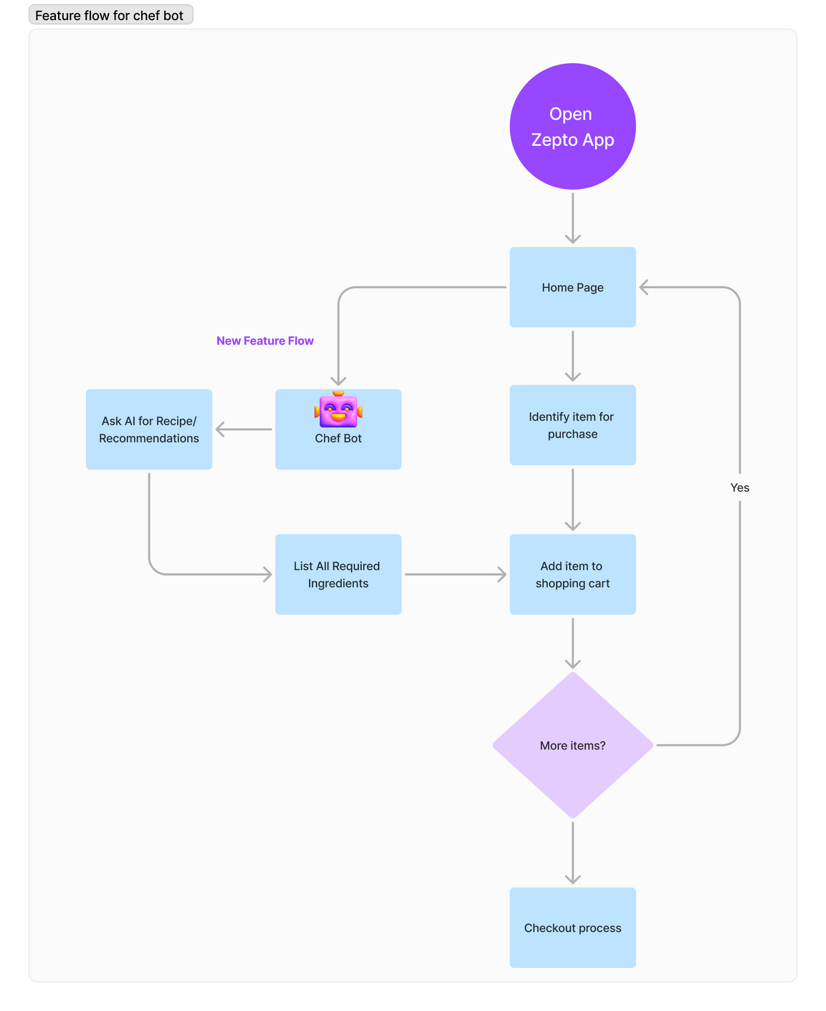
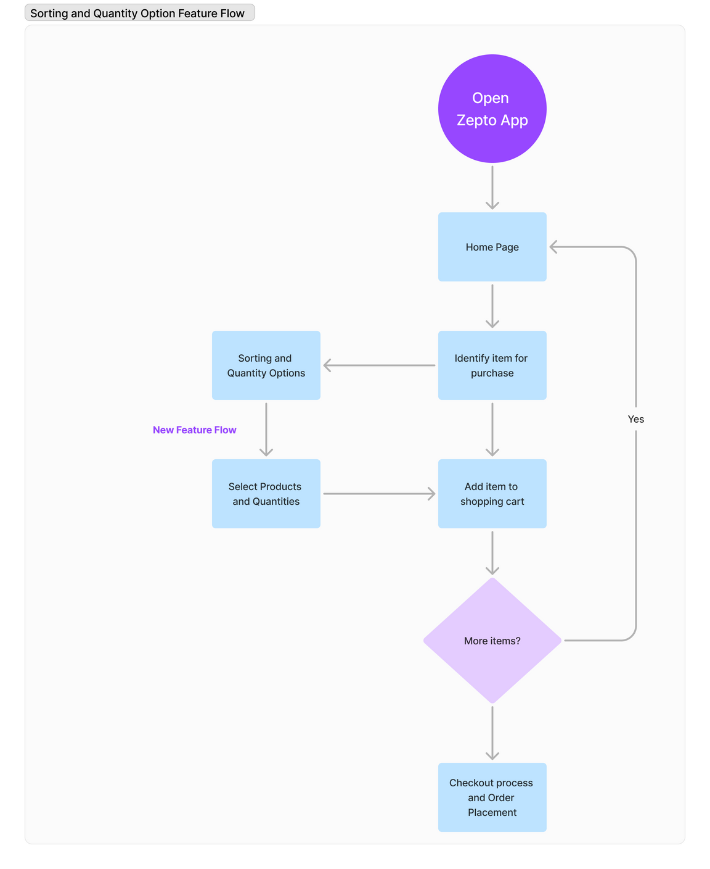
FEATURE FLOW FOR PRIORITIZED SOLUTIONS
CHEF BOT
SORTING AND QUANTITY OPTION

Slide 8
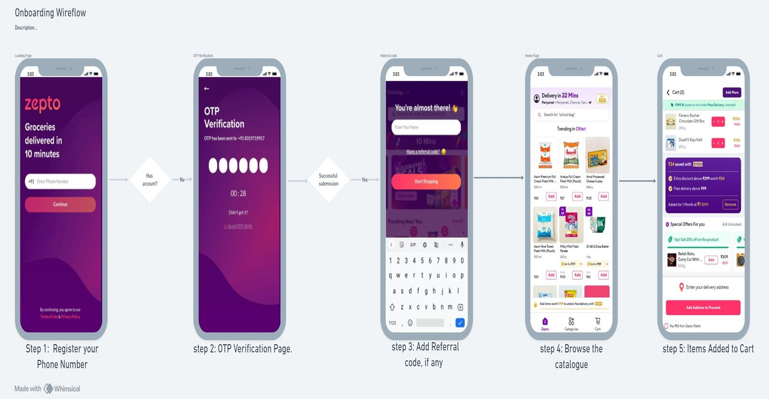
User Journey Through Zepto: Wireframe Overview

Slide 9
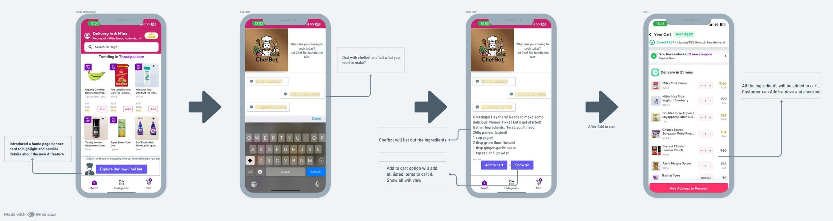
Wireframing of the Solution
Solution 1 : Chef Bot (AI-Driven Recommendations)
Home Page Introduction:
Chef Bot Chat Interface:
Ingredient List with Add to Cart
Cart Ready for Checkout:
Description: Zepto home page with a banner introducing Chef Bot.
Visual Elements: "Meet Chef Bot –
Your Cooking Assistant!" with a "Try Now" button.
Description: Chat interface where users interact with Chef Bot.
Visual Elements: Chat message:
"Hello! What do you want to cook today?" with input field.
Description: Chat lists ingredients needed with "Add to Cart" buttons.
Visual Elements: "To make Paneer
Tikka, you’ll need: [ingredients list].
Click 'Add to Cart'."
Description: Shopping cart with ingredients added, ready for checkout.
Visual Elements: View of the cart with ingredients and "Proceed to
Checkout" button.

Slide 10
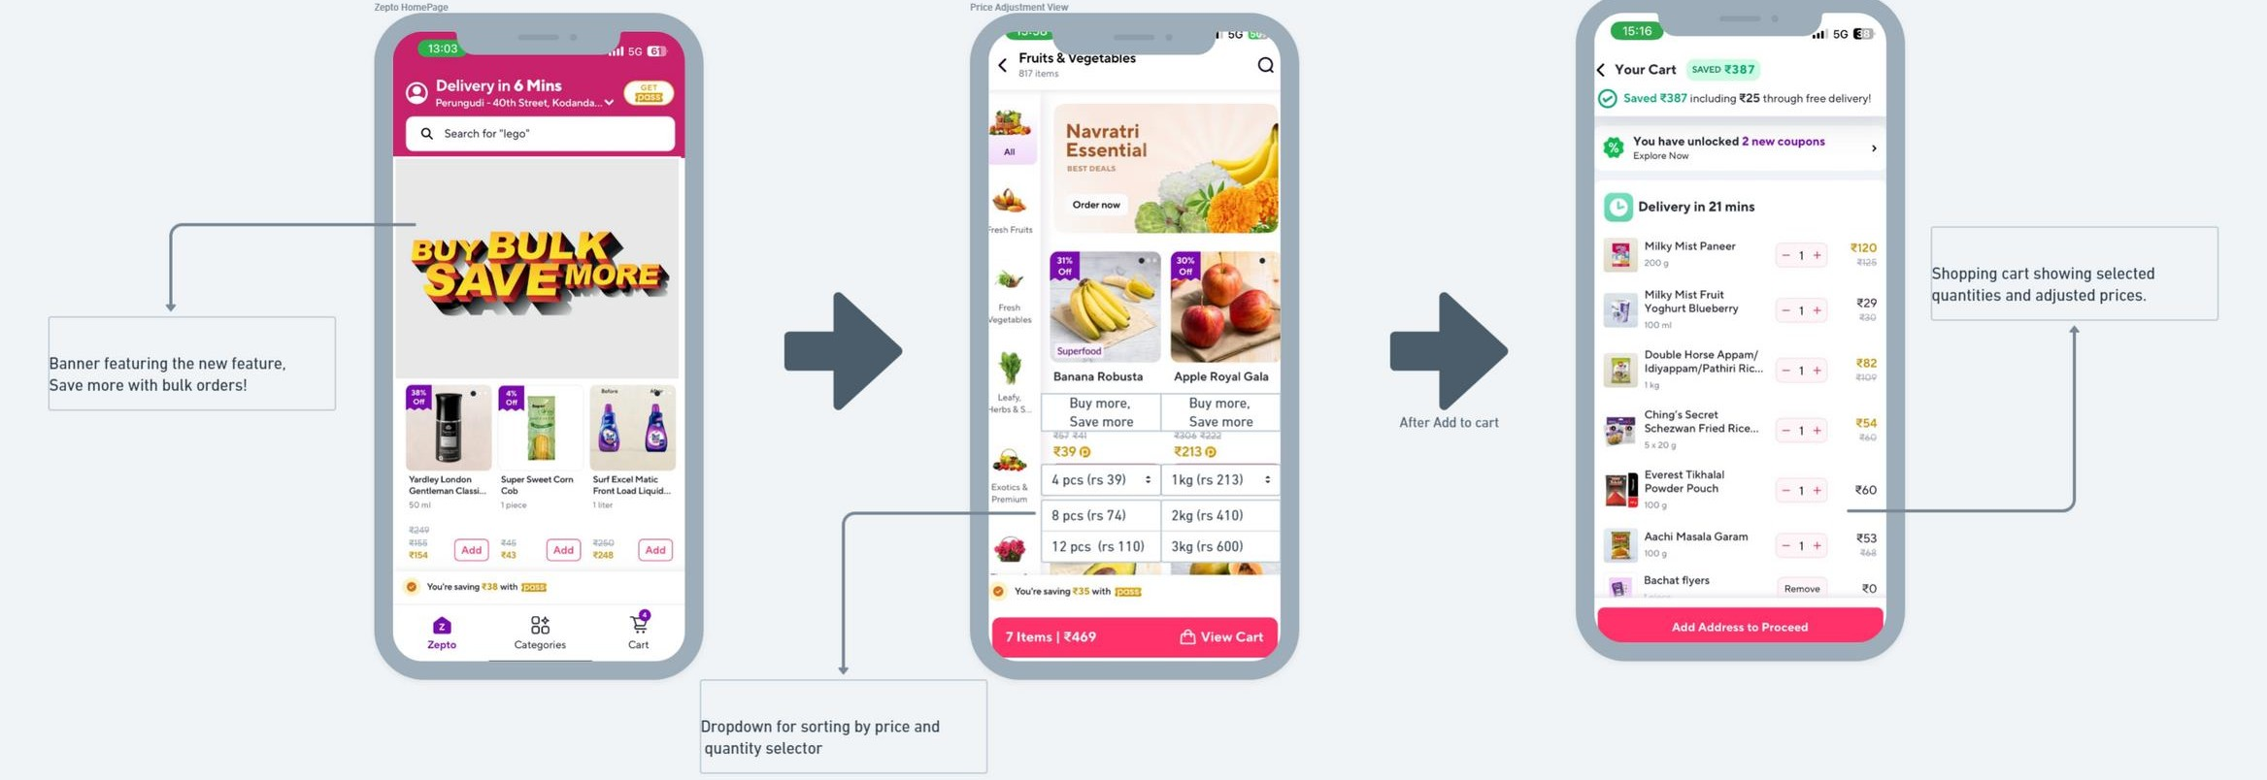

Wireframing of the Solution
Solution 2 : Sorting and Quantity Feature Flow
Home Page Introduction:
Price Adjustment View:
Price Adjustment View:
Description: Zepto home page with a banner introducing Chef Bot.
Visual Elements: "Meet Chef Bot –
Your Cooking Assistant!" with a "Try Now" button.
Description: Display adjusted prices
as quantities increase.
Visual Elements: "1kg Apple - ₹ 213 (save ₹10)" next to quantity selector.
Description: Shopping cart showing selected quantities and adjusted prices.
Visual Elements: View of the cart with bulk discounts and "Proceed to Checkout" button..

Slide 11
MEASURING THE PRIORITIES : FEATURE PRIORITIZATION
Formula :
RICE = Reach * Impact * Confidence Effort
Feature Prioritization using RICE
Framework
Solution
Reach(R) Impact(I)
Confidence(C)
Effort(E)
RICE Score
AI-Driven Recommendations (Chef Bot):
5
5
4
4
80
Sorting and Quantity Options:
3
4
4
3
48
Group Order:
4
3
4
3
48
Metrics for Measuring Success of Proposed Solutions
Potential Pitfalls in Solution Implementation
Metric | Definition | Measurement | Goal
Average Order Value (AOV) | The average amount spent per order. | AOV = Total Revenue / Number of Orders | Increase AOV by 30% within 6 months
Conversion Rate | Percentage of users who complete a purchase after interacting with Sorting and Quantity Option. | Conversion Rate = (Number of Purchases / Number of Users) * 100 | Improve by 10%
User Engagement Rate | Percentage of users engaging with the new features. | Engagement Rate = (No. of Engaged Users / Total Active Users) * 100 | Achieve 30% engagement
AI-Driven Recommendations (Chef Bot):
Accuracy: Potential inaccuracies in recommendations reducing user
trust.
Sorting and Increasing Quantity Option:
Technical Integration: Difficulty in integrating dynamic pricing
models.
User Confusion: Potential for users to be confused by varying prices
based on quantities
Group Order:
Coordination: Challenges in synchronizing orders from multiple users.
Complex Checkout: Increased complexity in the checkout process
due to multiple contributors.

Slide 12


